Slide 1



Twitter US Airline Sentiment
Abhinav Singh, MIT

Slide 2
Problem
Analyzing the tweet sentiments of travelers who flew on U.S. airlines. I have to answered various questions, like:
Text analysis of the user tweets to find out the reasons behind the user’s sentiments.
Find out which airlines which provide best and worst customer satisfaction.
Get the most discussed topics among various airlines.
Other interesting stats and graphs.

Slide 3
Twitter Data (Airline)
15000 users’ tweets and metadata; about their reaction/opinion/review about a particular airline.
CSV format.
Included Six Airlines for comparisons.
13 features used for associating analysis with inference

Slide 4
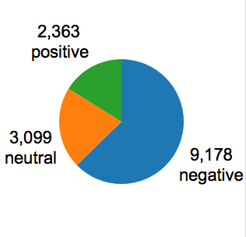
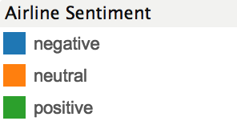
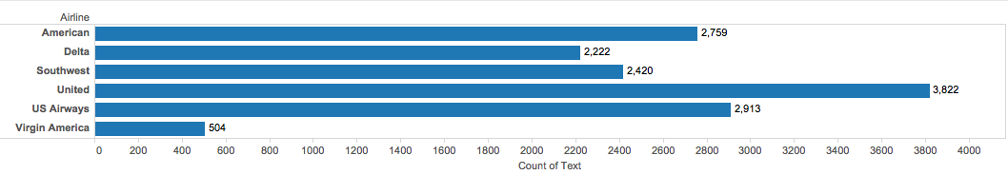
Overall Count of Tweets
Total Tweets: 14,640

Slide 5

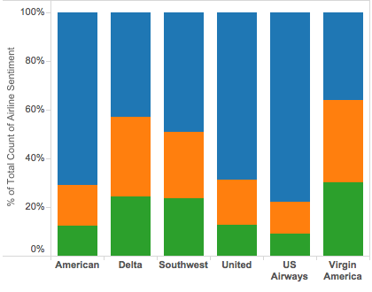


Proportion of Tweet sentiment by Airline
US Airways
Delta
Virgin America

Slide 6
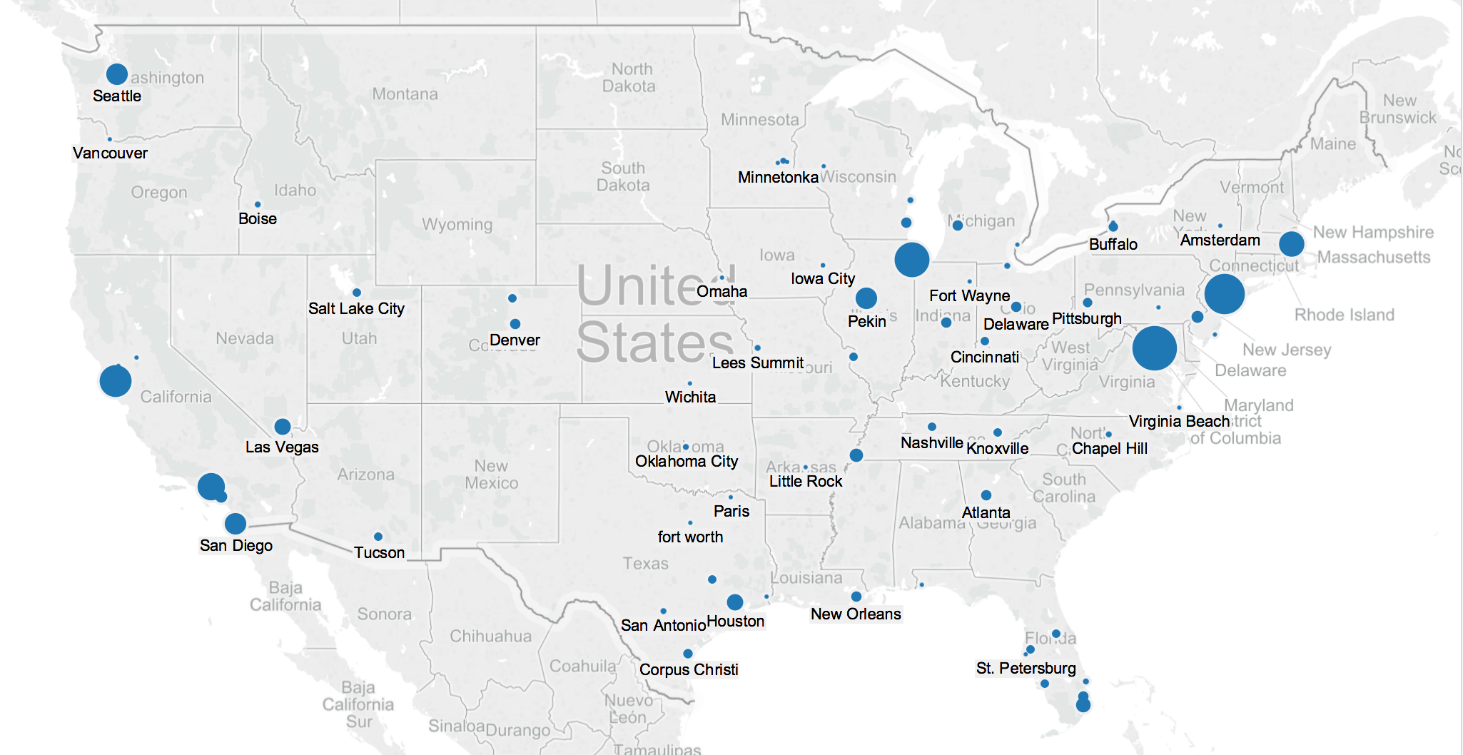



Where do most negative tweets come from?
Midwest:
Chicago
West Coast:
San Francisco
Los Angeles
San Diego
Las Vegas
East Coast:
Boston
New York
Washington
Notes:
From the map, we can see that most negative tweets come from big cities in mainly three parts of the US.
They come from east coast cities like Boston, New York and Washington and also from west coast cities such as san francisco, los angeles san diego and las vegas. There are also some negative tweets come from mid west like Chicago.

Slide 7
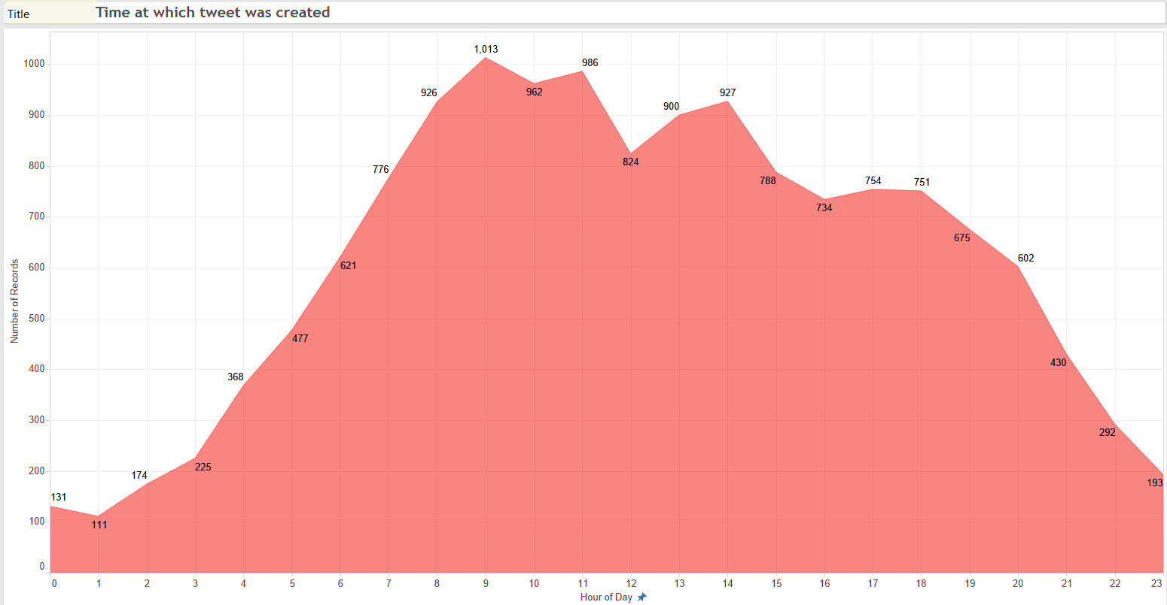
Time at which tweets were created

Slide 8
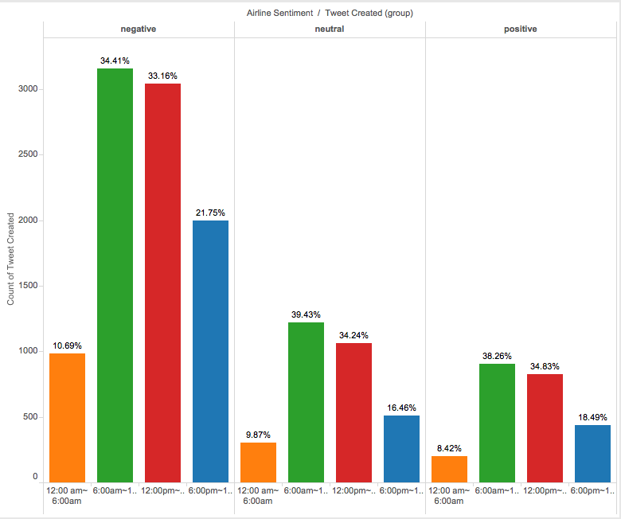

When do people tweet?
According to the chart:
People tweet most in the morning between 6:00 am to 12:00 pm
About 67.57% of the total tweets is published from 6:00 am to 6:00 pm.
Airline companies should monitor the tweets during this time period in order to build its social image
Notes:
According to the chart, we can see that people tweet most in the morning between 6:00 am to 12:00 pm. Check this green section in the positive, negative and natural tweets.
About 69.84% of the total tweets is published from 6:00 am to 6:00 pm. Airline companies should monitor the tweets during this time period in order to build its social image

Slide 9
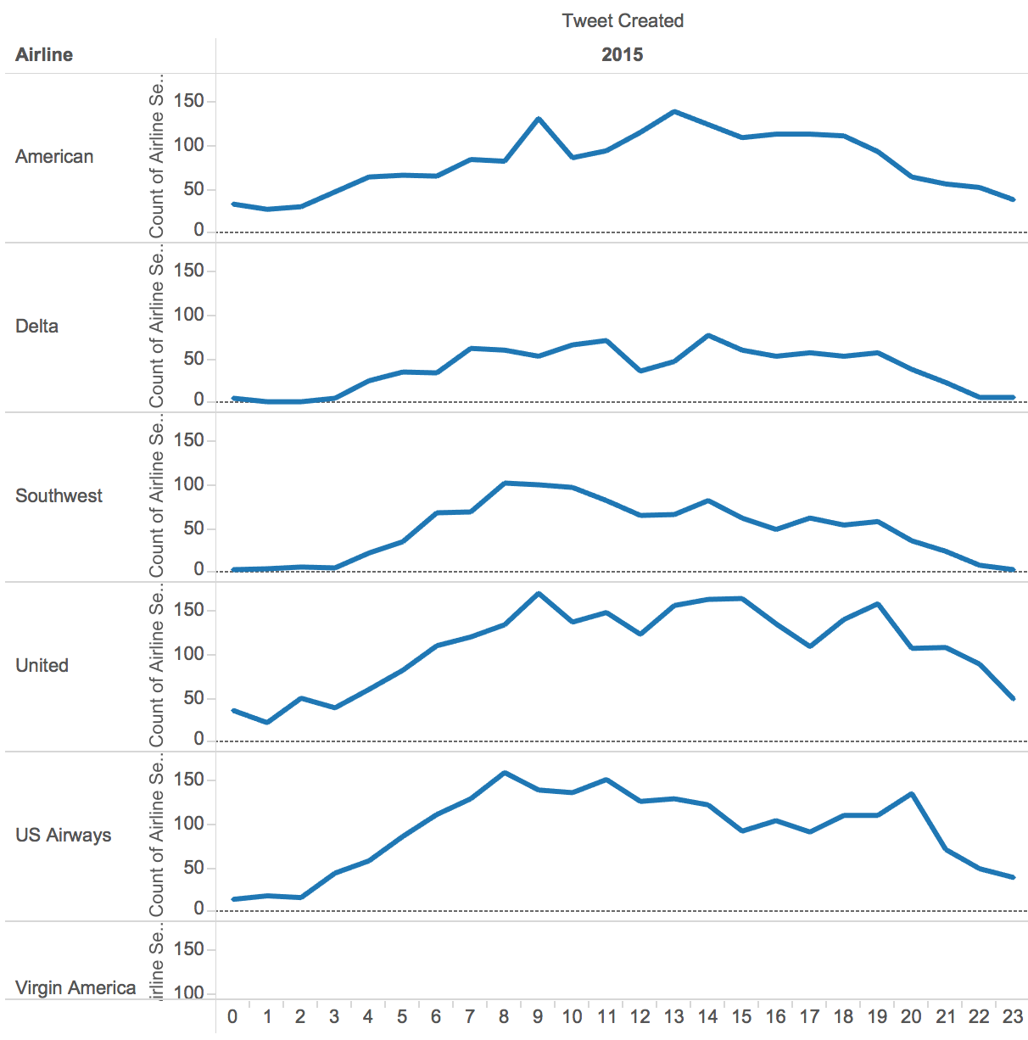
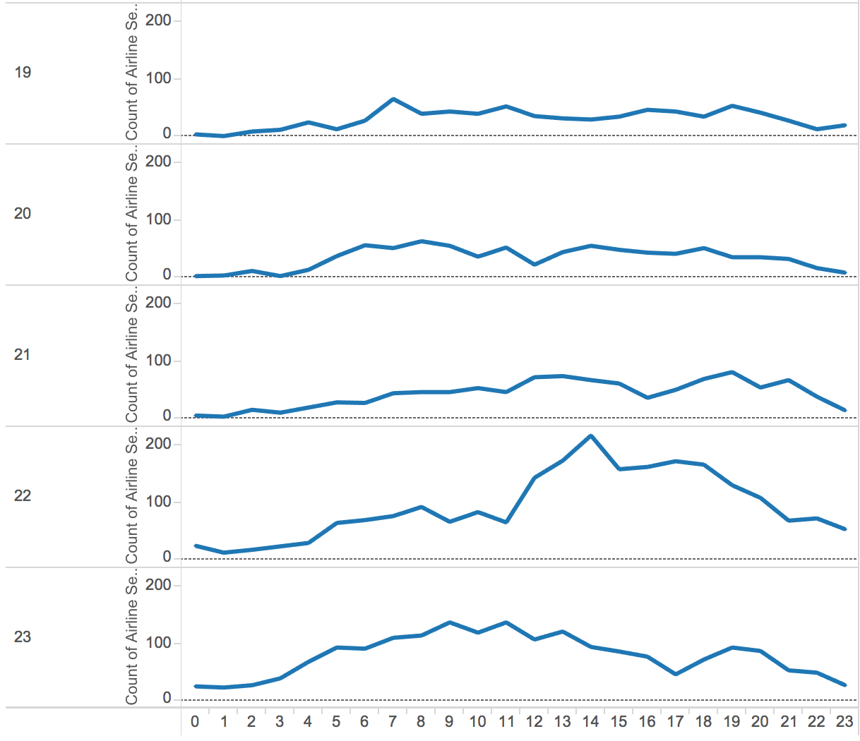

When do people tweet negatively?
Notes:
From the graph on the left, the X-axis shows the time while the y axis shows different airlines. We can see that most people tweets negatively from 8am to 4 pm. Most flights are ranged between 8-4 or are delayed or canceled during this period of time.. From the graph on the right, the x axis still shows the time while the y axis shows the date. Apparently, there is a spike on September 22nd and it means that something happened and influenced the flying experience.
Now I will show you a time lapse visualization that combines both when and where about negative tweet.

Slide 10
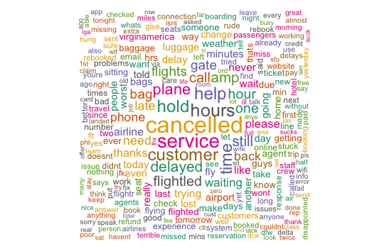
Overall Word Cloud for Negative Sentiment

Slide 11
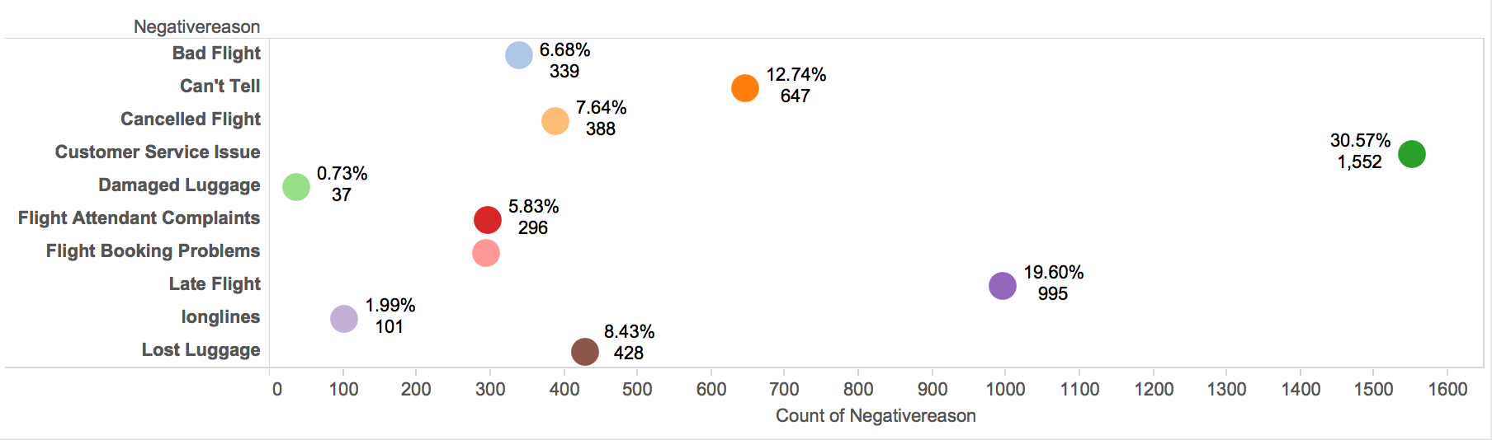
Negative Tweets by Reason

Slide 12
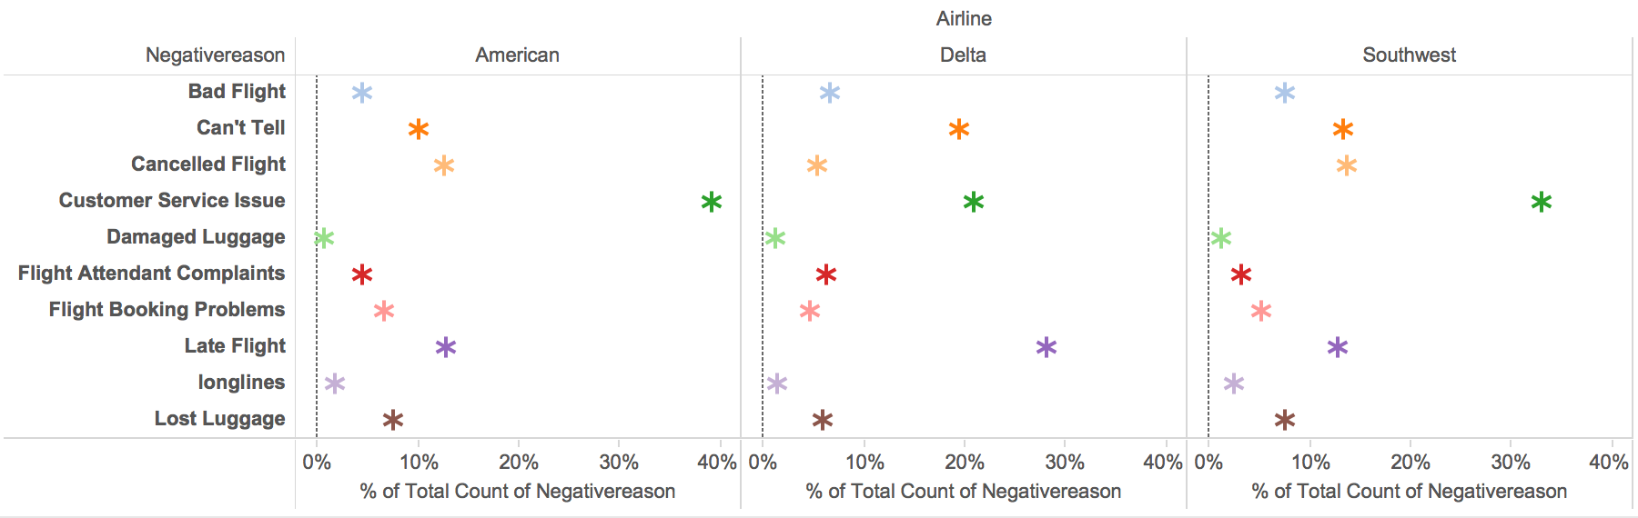
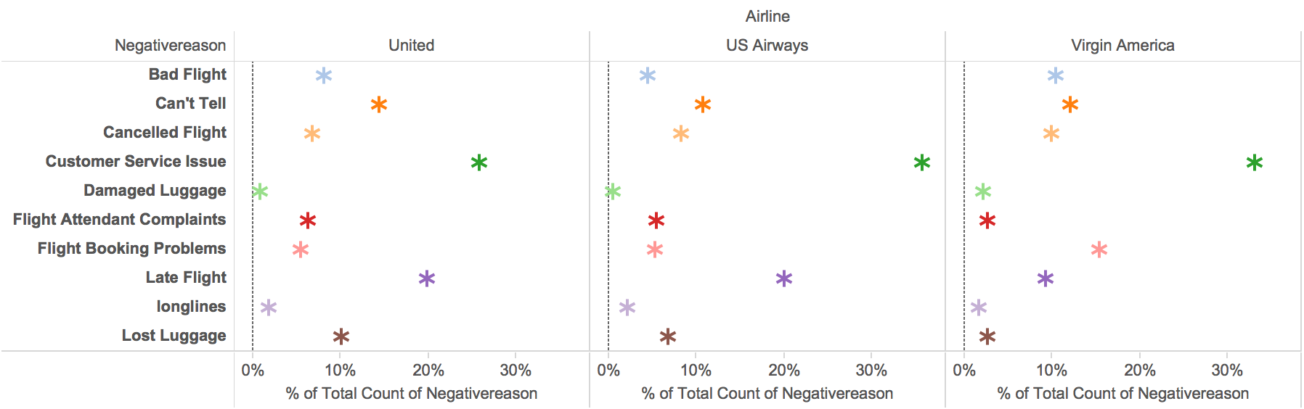

Slide 13
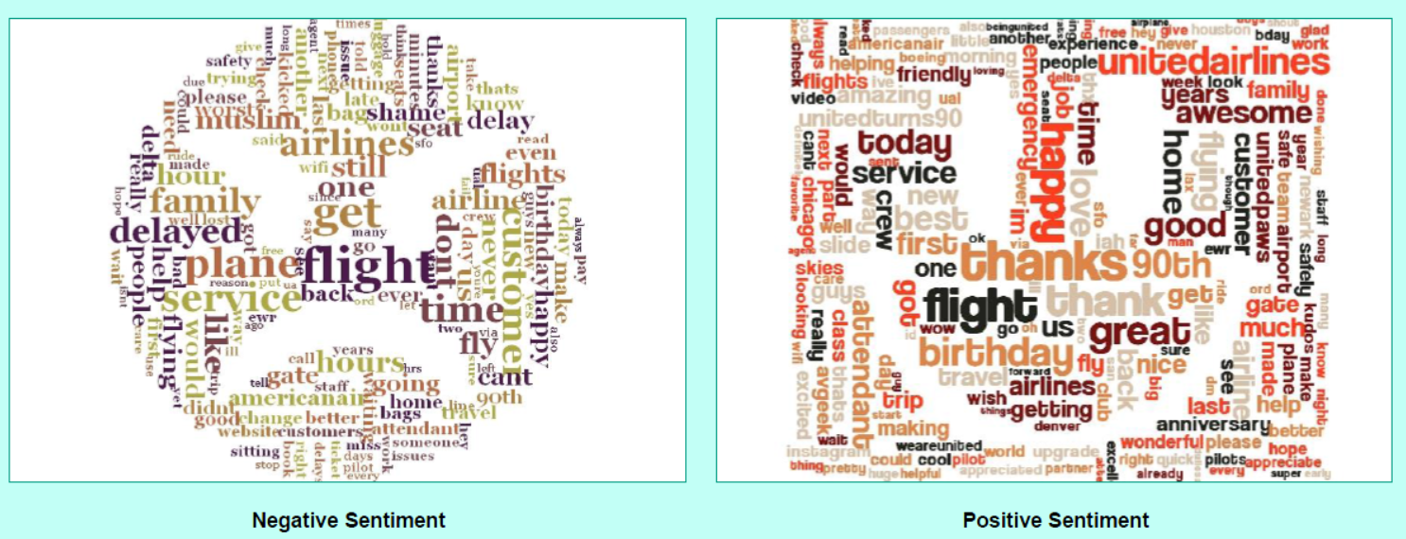
US AIRLINES

Slide 14
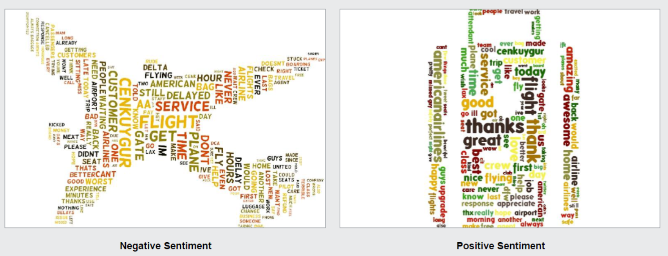
VIRGIN AIRLINES

Slide 15
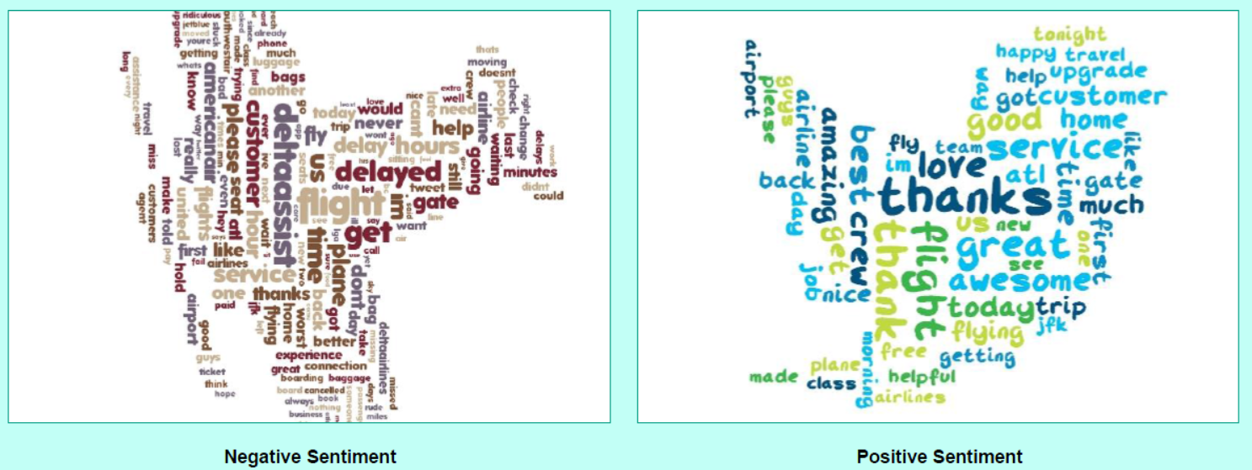
DELTA

Slide 16
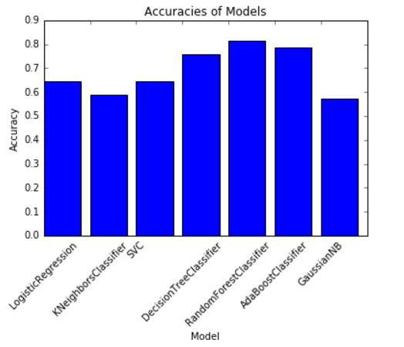
How can we predict the sentiment by Tweets?
Process of deriving high-quality information from text
Based on principles of Information Retrieval theory
Library tm & Sentiment in R

